Slide 1


A prospective trial of hypertension management using a telemedicine treatment approach
Patient Centered Meeting on Diabetes, Dyslipidemia and Hypertension
Wien 2019
Martin Carlsson MD, PhD
www.accumbo.se
martin@accumbo.se

Slide 2

CONFLICTS OF INTEREST
As conflict of Interest discosure for this presentation
The presenting author Martin Carlsson is a minority stockholder and founder of Acumbo AB
Gassan Dharwiche is a employee in Accumbo AB
First author Magnus Wijkman has no conflicts of interest that relate to this presentation
Fredrik Nyström has no conflicts of interest that relate to this presentation

Slide 3
Parts of this presentation has recently been accepted as a brief report in:
Blood Pressure Monitoring (BPMJ)
“A pilot study of hypertension management using a telemedicine treatment approach”
Accepted October 2019
Magnus Wijkman¹, Martin Carlsson^{2,3}, Gassan Darwiche^{2, 4} and Fredrik H Nystrom⁵
¹Department of Internal Medicine and Department of Medical and Health Sciences, Linköping University, Norrköping, Sweden
²Accumbo AB, Kalmar, Sweden
³Department of Medicine and Optometry, Linnaeus University, Kalmar, Sweden
⁴Department of Clinical Sciences, Faculty of Medicine, Lund University, Malmö, Sweden
⁵Department of Medical and Health Sciences, Linköping University, Linköping, Sweden

Slide 4
Hypertension is the major global cause of premature death
Globally, elevated blood pressure is the leading risk factor for mortality and morbidity, accounting for 7% of global disability adjusted life years and 9.4 million deaths in 2010.
(Lim SS, Vos T, Flaxman AD, et al. A comparative risk assessment of burden of disease and injury attributable to 67 risk factors and risk factor clusters in 21 regions, 1990-2010: a systematic analysis for the Global Burden of Disease Study 2010.Lancet. 2012; 380:2224–2260. doi: 10.1016/S0140-6736(12)61766-8)

Slide 5
Bad blood pressure Control worldwide
Worldwide only 40 % of patients with hypertension are treated
Of these, only less than 35 % are controlled to a BP of <140/ 90 mmHg
Hypertension is a lifelong, mostly asymptomatic condition: patient has to weight future benefits with today's burden of treatment (cost, effort and side effects)
Therefore it is important to involve patients in the decision to treat elevated BP and in choosing medications. Educate and provide feedback about the harms of high BP and the benefits of treating elevated BP
Chow CK et al , PURE Study Investigators. Prevalence, awareness, treatment, and control of hypertension in rural and urban communities in high-, middle-, and low-income countries. JAMA 2013;310:959–968

Slide 6
Home blood pressure monitoring (HBPM)
Home blood pressure monitoring (HBPM) as part of hypertension management is now recommended in European as well as American guidelines and there is a growing interest in telemedicine as part of the management of hypertension
Novel technological solutions such as telemedicine solutions may promote self management, leda to increased empowerment and facilitate feedback and interaction between users and healthcare providers
Very few (less than 2%) commercially available apps for hypertension management are developed by healthcare professionals

Slide 7
Aims of the Study
The present study represents and effort to develop an evidence-based telemedicine solution for hypertension management that will increase and enhance the interaction between patient and physicians
To investigate if home BP measurements combined with telemonitoring based on a smartphone application increased the proportion of patients with controlled hypertension during three months.

Slide 8
Ethics
The study was approved by the Regional Ethics Committee of Linköping and performed in accordance with the Declaration of Helsinki of 1975
The ClinicalTrials.gov ID number NCT03908710
The communication between the patient application (client) and the system cloud service (server) and all the saved data were encrypted
The medical technical system was developed in accordance with the Swedish Patient Data Act, the National Board of Health and Welfare's regulations on record keeping and the Data Protection Regulation (GDPR)

Slide 9
Methods and inclusion criteria
172 patients (78 men and 94 women) between 35-70 years, diagnosed with primary hypertension
Prescribed at least one and no more than three antihypertensive drugs
Iphone owner with access to electronic ID (Swedish BankID) to which the dedicated ACCUMBO software (app) was downloaded.
Blood and urine samples were collected at local laboratories
Lab personnel instructed patients to measure the blood pressure (BP) in the sitting position after 5 min of rest
We compared the CE-labelled Bluetooth-equipped oscillometric BP monitor (Truly Instrument Limited, Hong Kong, China)with an Omron M6 Comfort monitor (Omron, Kyoto, Japan). No bias was found

Slide 10
Exclusion criteria
(all according to patient´s self-reporting)
Secondary Hypertension
Previous Stroke, previous Myocardial infarction
Known Heart failure, known Arrhythmia
Severe Renal failure (GFR<30)
known Dementia
known Diabetes Mellitus
On-going Pregnancy

Slide 11
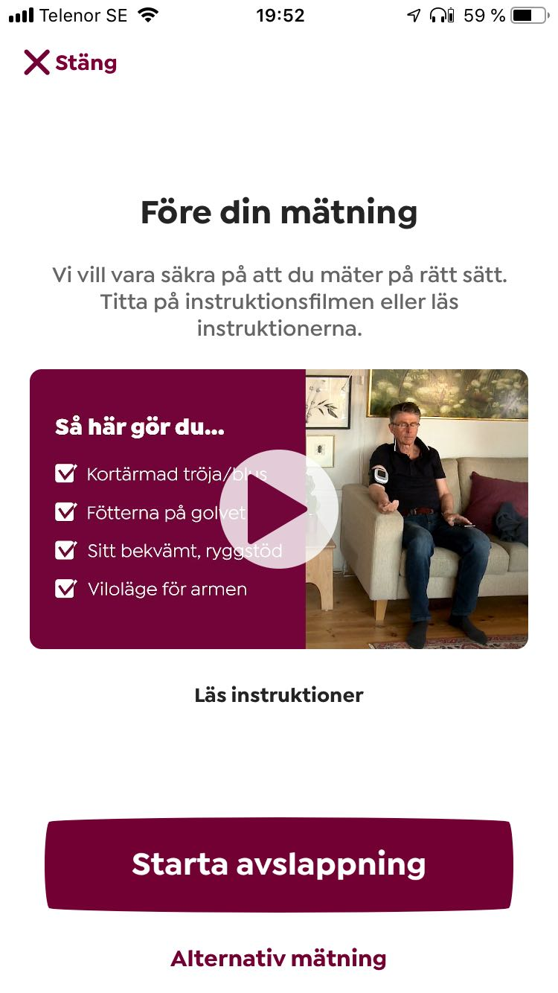
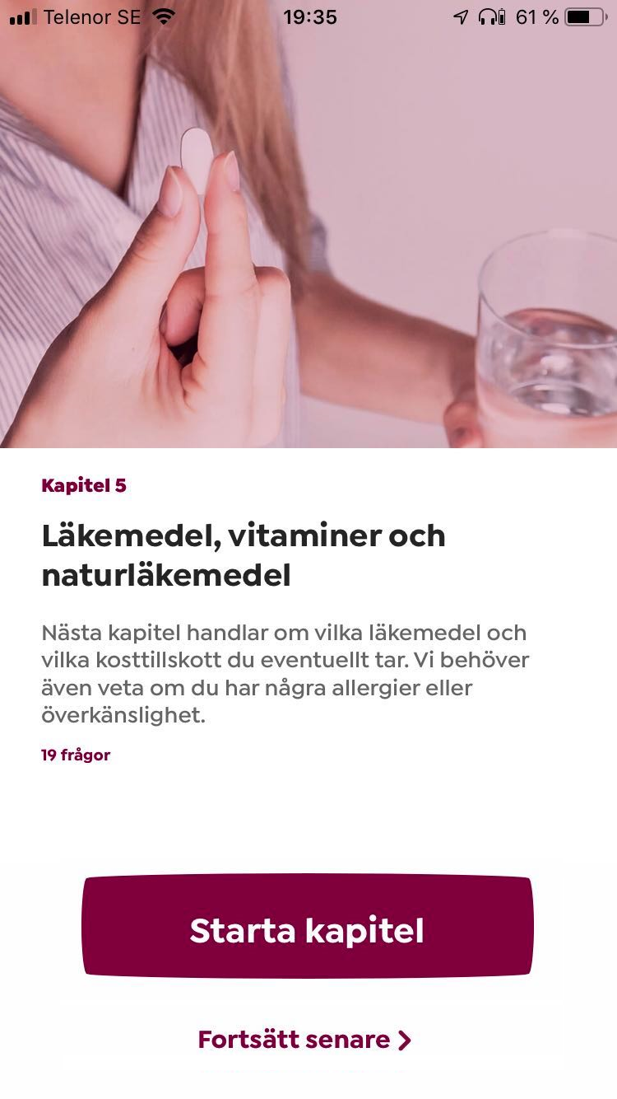
Questionnaire in the app
The patients received instructions in the app, supported by a video link, about how to perform BP measurements in a standardized manner in their home.
A questionnaire (140 questions) was filled in electronically by the participant via the smartphone app
On-going medication
Hypertension history/ treatment, ongoing symptoms, concomitant diagnoses, life-style factors, heredity etc
Anthropometric data (weigh, waist, length).

Slide 12
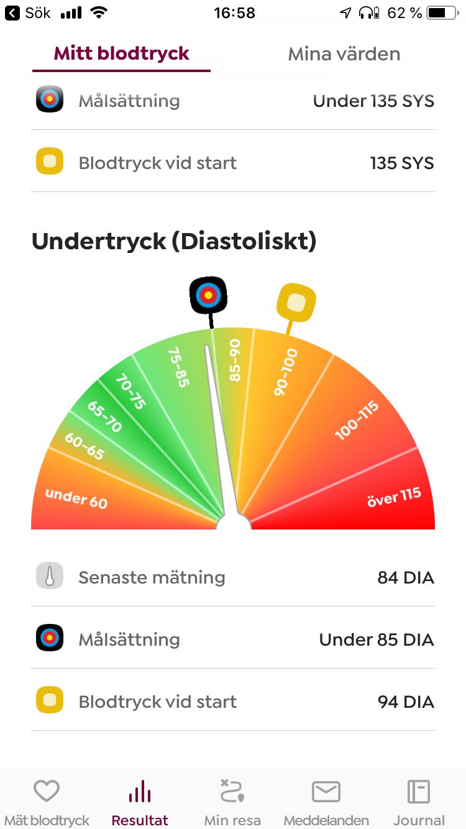
Home blood pressure measurements during the first two weeks
Participants measureed their blood pressure on at least seven days in the morning (before breakfast) and on at least seven days in the evening.
Two measurements were carried out during each occasion and the mean blood pressure value was displayed.
If the systolic or diastolic BP differed more than 7 mmHg between the two measurements, a third measurement was made by the patient and the mean between the second and third measurements was calculated.
The patient could see the development of the blood pressure in a graph and in a colour graded gauge meter

Slide 13
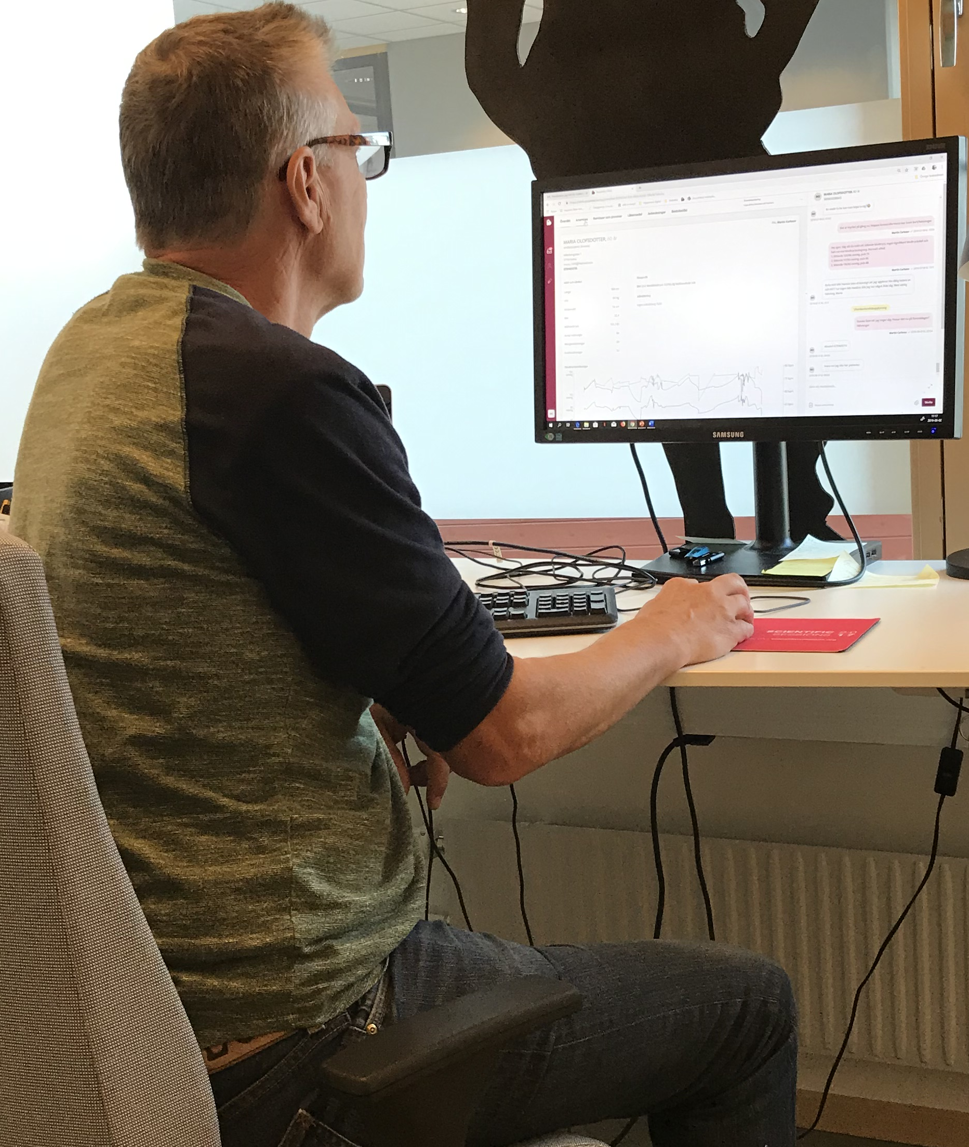
Notifications to doctor, chat with patient and extra measurements
The study physician could see the same data as the patient and was alerted through automated notifications in the medical record system in case of exceedingly high (>190 systolic BP and/or >115 mmHg diastolic BP) or low BP values (systolic BP < 110 mmHg).
By using the chat function in the smartphone app, the patients could send messages to the study physician at any time, and the study physician usually responded within 24 hours on weekdays.
Additional measurements were not included in the mean blood pressure calculations
Orthostatic blood pressure measurements (heart rate and blood pressure measurement in sitting and standing after 1 and 3 minutes,
The study physician also automatically also received information recordings performed when the patient perceived symptoms that could be blood pressure related such as palpitations, dizziness, headache etc.

Slide 14
Blood pressure (BP) targets
If mean BP values were above target (BP > 135/85 mmHg) a follow-up was planned after two weeks and patients could be referred for extra lab tests
If a sitting BP < 110 mmHg), or if dizziness was reported, patients were asked to perform additional seated blood pressure measurements followed by readings after 1 and after 3 minutes in the standing position.
the medication could then be reduced or changed, as judged appropriate according to the treating physician.

Slide 15
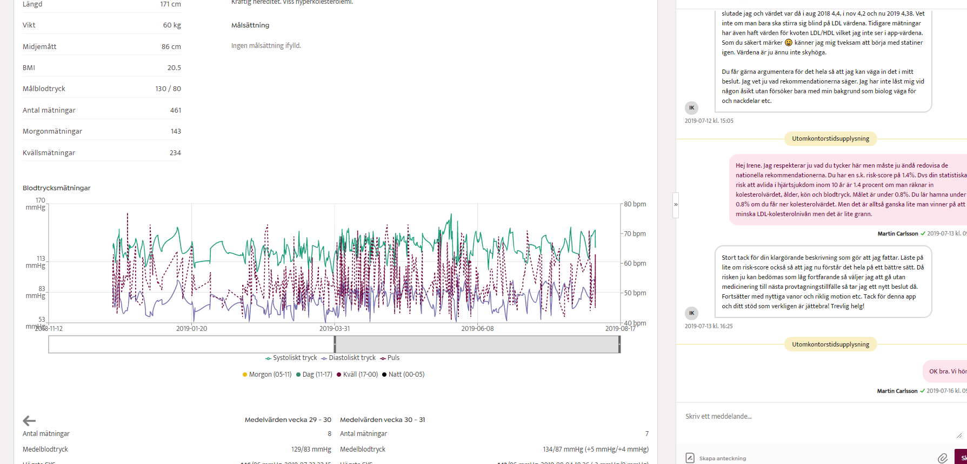
Our Medical Record System
BP measurements
Chatt
Questionnaire
Decision support system
Drug list and prescription
Laboratory analysis
LifeStyle support

Slide 16
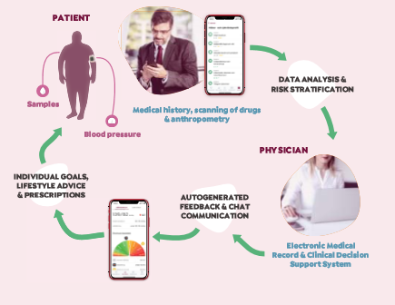

Slide 17
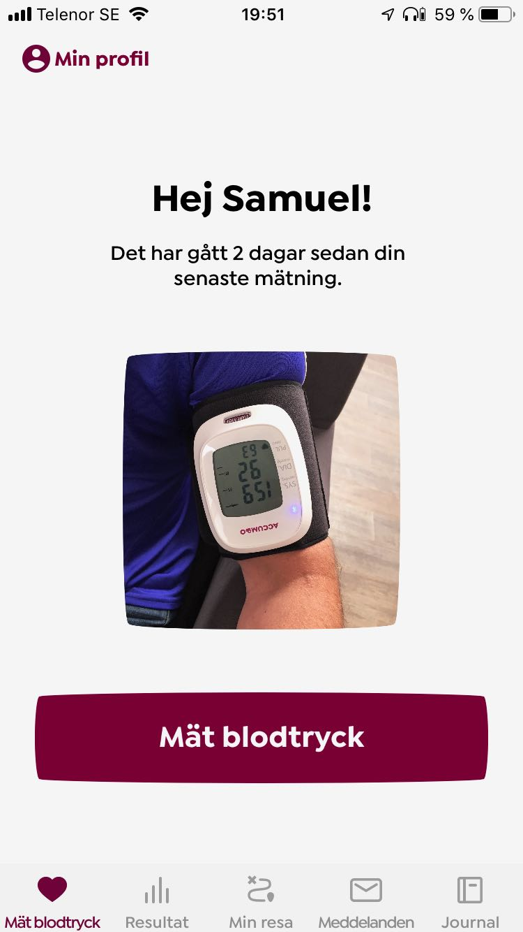
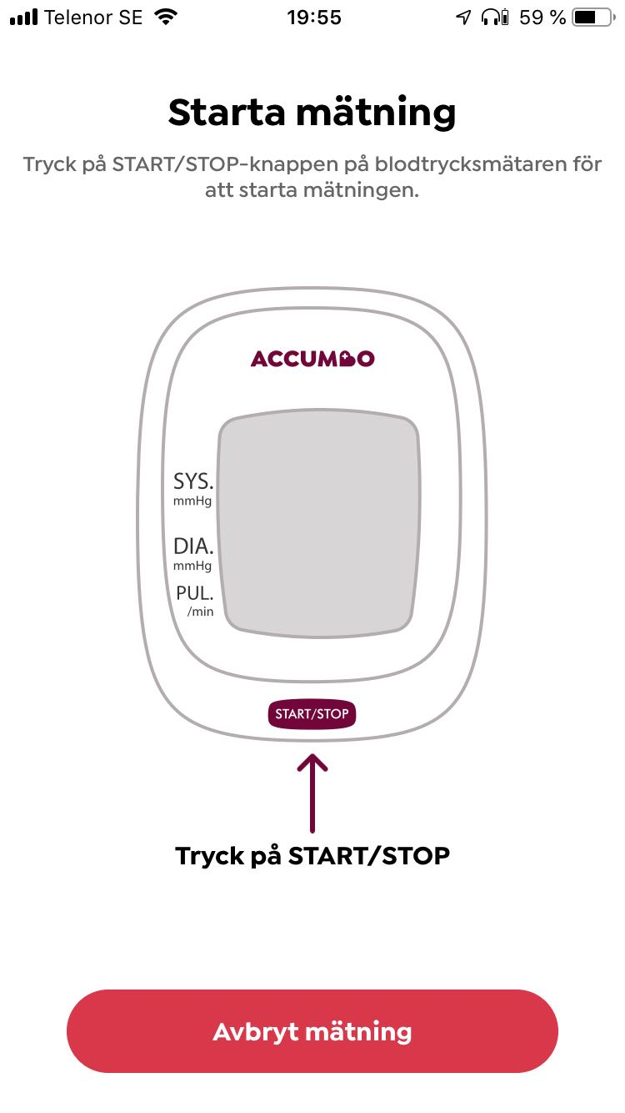
Measurements

Slide 18
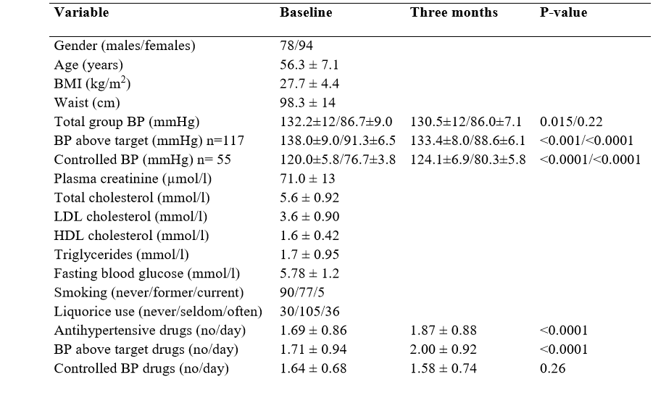
Baseline characteristics

Slide 19
Follow-up
Patients were followed for three months and were instructed to measure their BP regularly throughout the study period
At the end of the study, an anonymized questionnaire about how the smartphone application was perceived was sent to all participants.

Slide 20
Initial blood pressure
No difference between the first BP measurement with the reference Omron M6 device and the ACCUMBO monitor at the start of the trial (ACCUMBO: 134.0±16 / 88.2±11mmHg, Omron M6: 134.5±15 / 88.5±11mmHg, p= NS
The mean home BP during the first week of the trial was slightly lower 132.2±12 / 86.7±9.0 mmHg

Slide 21
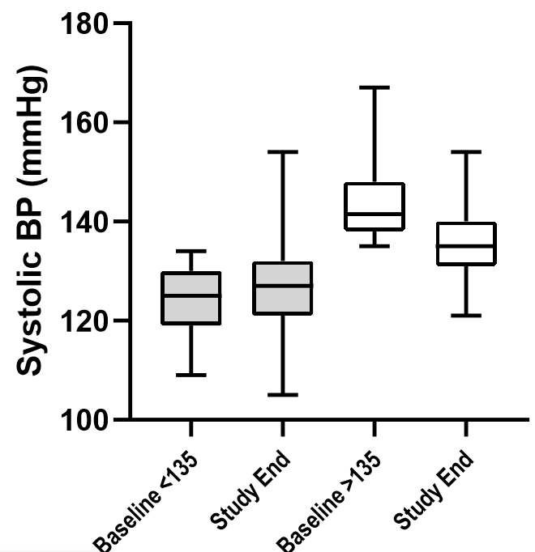
Changes in blood pressure
The 117 patients with home blood pressures above target during the first week had their BP lowered (from 138.0±9.0 / 91.3±6.5 mmHg to 133.4±8.0 / 88.6±6.1 mmHg, p< 0.001 for SBP and p< 0.0001 for DBP, respectively)
Their number of prescribed antihypertensive drugs/day increased significantly (from 1.71±0.94 / day to 2.00±0.92 / day, p < 0.0001).

Slide 22
Changes in blood pressure in patients with initially low BP
In patients in which the blood pressure lowering medication was reduced due to hypotension (defined as sitting SBP < 110 mmHg) or due to self-reported hypotensive symptoms in combination with confirmed orthostatic hypotension.
BP rose from 110.7±1.5 / 74.4±1.8 mmHg the first week to 122.9±6.9 / 82.4±4.7 mmHg at the end of the trial (P <0.001 for both SBP and DBP).

Slide 23
Experience of the treatment approach
Overall, 166 of the patients participated in the questionnaire in the end of the trial
The overall treatment and service during the trial
A question regarding how difficult it was to use the BP monitor at home
A question concerning the perceived care quality
Question whether they would like to continue using the service or not

Slide 24
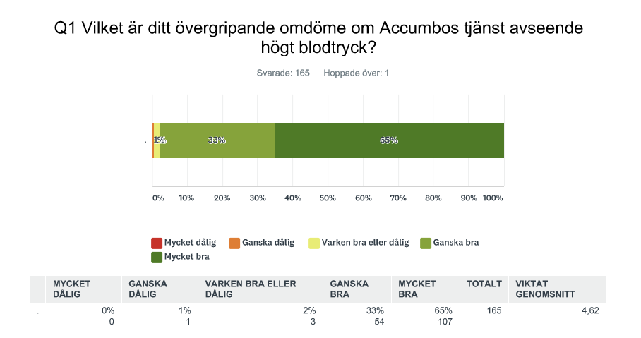
The overall treatment and service
Was rated as
“very good” by 107 participants (65%),
“fairly good” by 54 participants (33%),
“not bad/not good” by three participants (2%)
and
“rather bad” by 1 participant (1%).

Slide 25
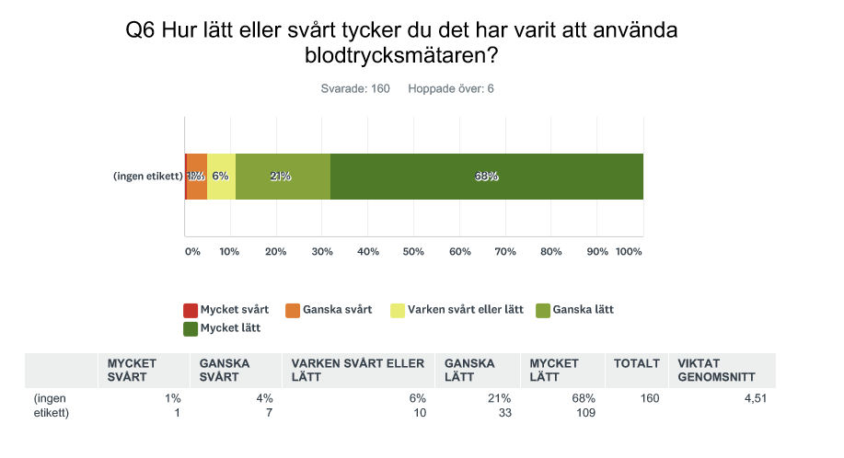
Not difficult using the BP monitor
109 (68%) reported that they found the Blood pressure monitor and the appit “very ease” to use,
33 (21%) responded “fairly easy”,
10 (6%) responded “neither easy nor difficult”,
seven (4%) responded “fairly difficult”
and
one participant (<1%) responded “very difficult to use”.

Slide 26
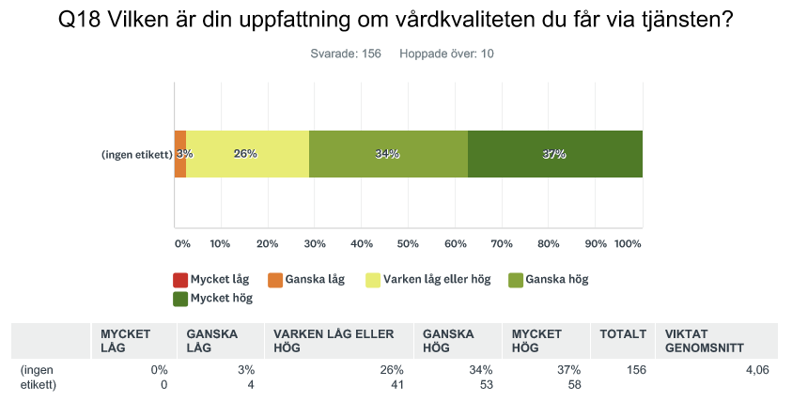
A question concerning the perceived care quality
There were 58 (37%) who rated the care quality as “very high”,
53 (34%) who rated it as “fairly high”,
41 (26%) who rated it as “neither low nor high”
four (3%) who rated it as “fairly low”.
No participant rated the care quality as “very low”.

Slide 27
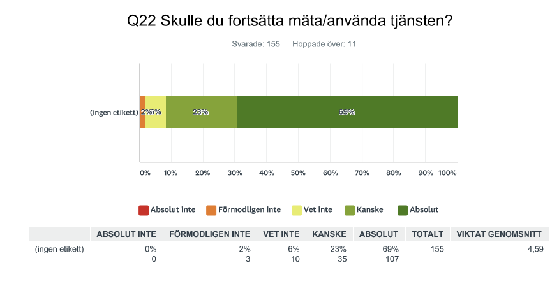
A question whether they would like to continue using the service or not
107 of these (69%) answered “yes, definitely”,
35 (23%) responded “maybe”,
10 (6%) answered “do not know”
three (2%) answered “probably not”
No participant answered that they would “definitely not” want to continue using the service.

Slide 28
Conclusion
To summarize,
we prospectively evaluated home blood pressure levels in patients with treated hypertension who used a telemedicine healthcare management system which allowed continuous communication between physician and patient via a smartphone application.
We found improved blood pressure values in patients with initial refractory hypertension, while too low blood pressure values were avoided in patients with initial hypotension.

Slide 29
Discussion
We believe that this was achieved both by an increasing number of antihypertensive medications, but also by enhanced communication between physician and patients which facilitated a healthy lifestyle.

