Slide 1
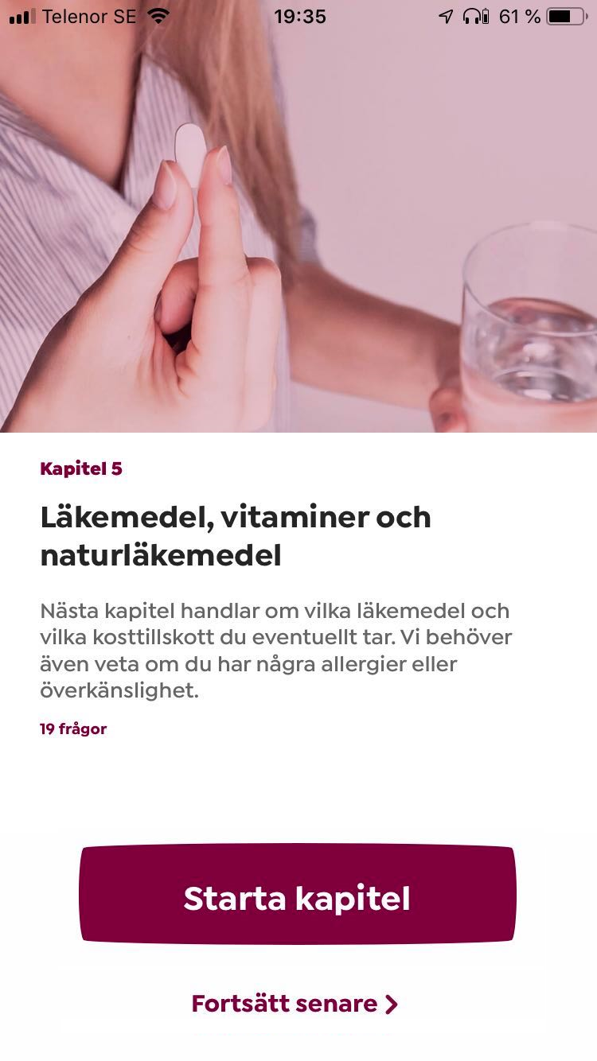
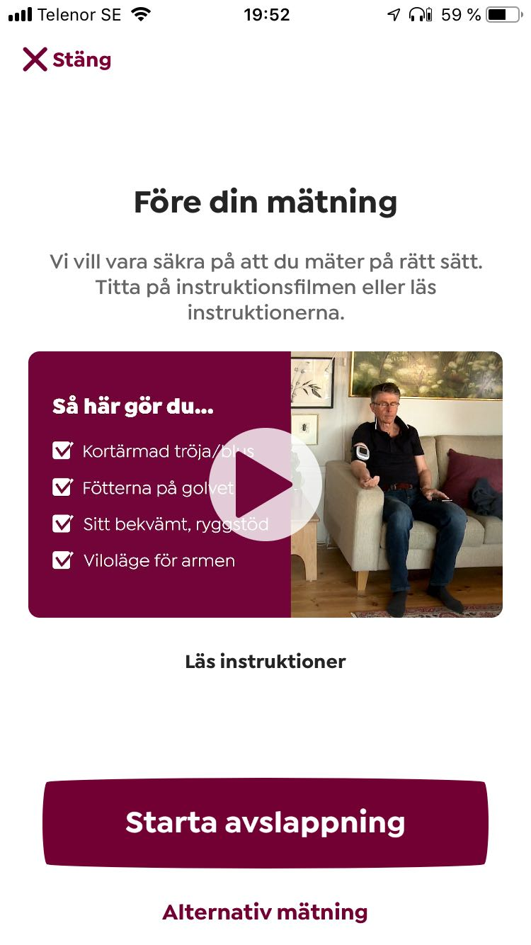
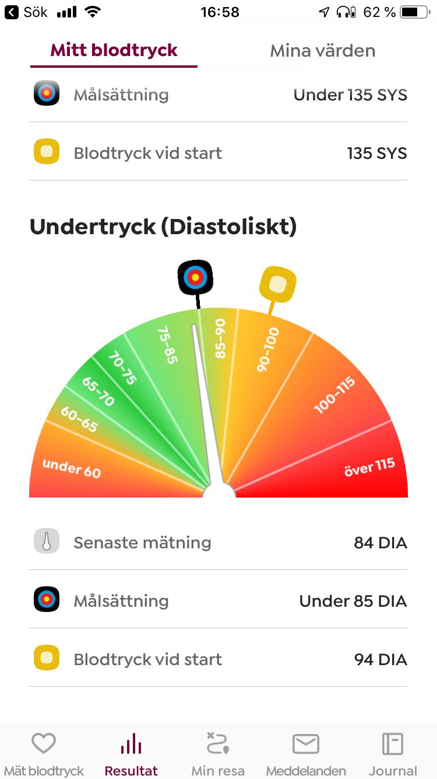
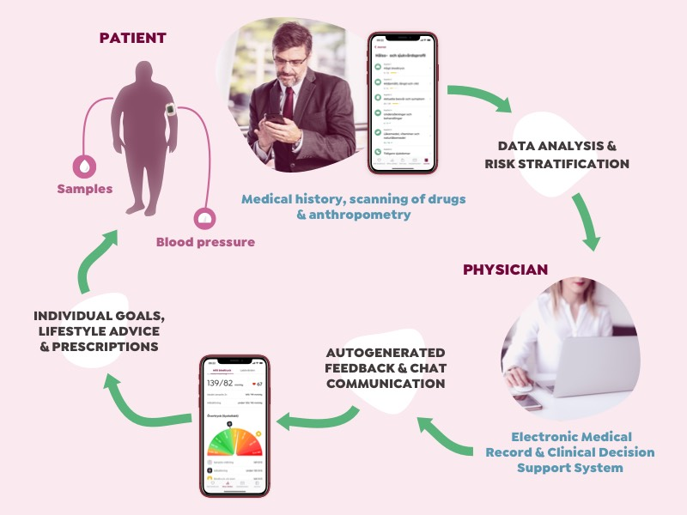

Blood Pressure Doctor – A New Evidence-Based Effective Digital Care System for Hypertension Treatment Using Telemedicine and Mobile Health Technology
Gassan Darwiche^{1,2}, MD, PhD, ghassan@accumbo.se, Martin Carlsson^{1,3}, MD, PhD, martin@accumbo.se
¹Accumbo AB, Kalmar, Sweden, ²Dep of Clinical Sciences, Faculty of Medicine, Lund University, Malmö, Sweden, ³Dep of Medicine and Optometry, Linnaeus University, Kalmar, Sweden
Background and Aims
Hypertension is quantitatively the most important risk factor for CVD and death in the world. Despite extensive knowledge treatment results from current methods are poor. Present ways of treating hypertension in traditional care has been criticized for deficiencies such as too few BP readings, long periods between readings for drug adjustments and lack of coaching of lifestyle changes. Home blood pressure monitoring (HBPM) is now recommended in European and American guidelines and there is a growing interest in telemedicine as part of hypertension management. Blood Pressure Doctor (BPD) is one of the world's first all-inclusive digital healthcare system for management of patients with hypertension. The aim is to provide a more effective treatment using HBPM combined with remote care and telehealth technologies.
Health data compiled together with medication, lab test results and individual risk factor interpretation are presented to the doctor. The patient app and the doctor's medical record reflect each other and basically contain the same information (Figure 4). Automatically generated feedback is reinforced through gamification and given to the patient in the app together with treatment recommendations trough asynchronous physician chat communication.
Methods
The care concept is based on a patient smartphone application and a clinical decision support system (CDSS) for doctors (Figure 1). Patients gets the BPD application downloaded to their smartphone after initial triage and a validated and quality-certified CE-labeled Bluetooth-equipped oscillometric BP monitor (Truly Instrument Limited, Hong Kong, China) is sent home to them. Using their personal bankID patients can log in to the smartphone application to answer medical health related questions (Figure 2). Patients enters or scan their medicines in the drug list, which is then transferred to the medical record and the CDSS. Using the chat function in the mobile patients can communicate with their dedicated patient-responsible doctor at any time. The patients are also referred for screening of selected lab tests and instructed on how to measure their BP in a standardized manner in their home supported by a simplified instruction video in the app (Figure 3). Home BP data are transferred via Bluetooth to the app and medical record forming a basis for continuous monitoring, medical treatment and intense behavioral coaching.
Fig 2. Questionnaire Fig 3. Measuring BP Fig 4. BP data
Results
Both clinical results and patient experience are positive, and the service has received very high ratings from the patients. Patients diagnosed with primary hypertension having ongoing treatment in outpatient care in Sweden, were evaluated after 3 months hypertension management using the BPD service¹. The results show significant further improved blood pressure levels in a majority of patients with hypertension despite previous treatment in primary care. Two third of the patients with elevated home BP values during the first week’s assessment had a further 5mmHg reduction in systolic BP and 3 mmHg reduction in diastolic BP after 3 months. The level of BP reduction corresponds to a reduced risk of stroke and heart failure with 20-25% and risk of coronary heart disease with 15%. BPD as a care concept received very high total scores in the patient survey: 98% replied that the service is good or very good and 92% would recommend it to family and friends.
Conclusions
Proper hypertension management requires pharmacological and non-pharmacological interventions. The use of virtual health intervention and HBPM has been shown to improve empowerment, compliance and BP control. Blood Pressure Doctor is a telemedicine solution for hypertension management that offers a new scientifically validated and evidence-based innovative digital care concept well suited to deliver medical care and individual lifestyle advice also for diabetes patients.
Figure 1. The care concept of the Blood Pressure Doctor
¹A pilot study of hypertension management using a telemedicine treatment approach. Blood Press Monit. 2020 Feb;25(1):18-21. Wijkman M, Carlsson M, Darwiche G, Nystrom F.
Accumbo AB • Kalmar, Sweden • www.accumbo.se

